Slide 1

WEEK 0
DAY 0
Command Line

Slide 2
Command Line
What is a Programming Language?
Syntax
Talk to the Computer
Navigation Exercise
List of basic commands

Slide 3

WHAT IS A PROGRAMMING LANGUAGE?
What language does your computer speak?
Notes:
Ask questions, eliciting for “binary”

Slide 4
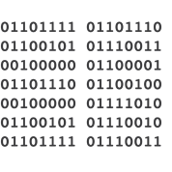
WHAT IS A PROGRAMMING LANGUAGE?
What language does your computer speak?
Binary!
Notes:
“Of course, we humans don’t speak binary (most of us anyway!), so we need something to help convert binary into a language we can understand”

Slide 5
WHAT IS A PROGRAMMING LANGUAGE?
What language does your computer speak?
Binary!
We need an interpreter…
Notes:
“We call this middleman an interpreter”
“If our computer needs to tell us something, the interpreter can relay that information to us, too. Such as with error messages and data queries”

Slide 6
WHAT IS A PROGRAMMING LANGUAGE?
What language does your computer speak?
Binary!
We need an interpreter…
Introducing JavaScript (aka JS) !
They really drew me with hands?
Notes:
“JS serves as an interpreter for executing computer commands”

Slide 7
MANY DIFFERENT LANGUAGES
Name some programming languages you know or have heard of.
Notes:
Have students call out other languages they’ve heard of

Slide 8
MANY DIFFERENT LANGUAGES
Name some programming languages you know or have heard of.
JavaScript
Ruby
Java
Python
Haskell
PHP
C#
C++
Many more!

Slide 9
MANY DIFFERENT LANGUAGES
Name some programming languages you know or have heard of.
What’s the difference?
Notes:
Asking, “what’s the difference between programming languages?” might result in a myriad of responses from students.
Try to elicit “syntax”, but if students don’t reach that conclusion, just give them the answer and move on.

Slide 10
MANY DIFFERENT LANGUAGES
Name some programming languages you know or have heard of.
What’s the difference?
Just syntax!

Slide 11
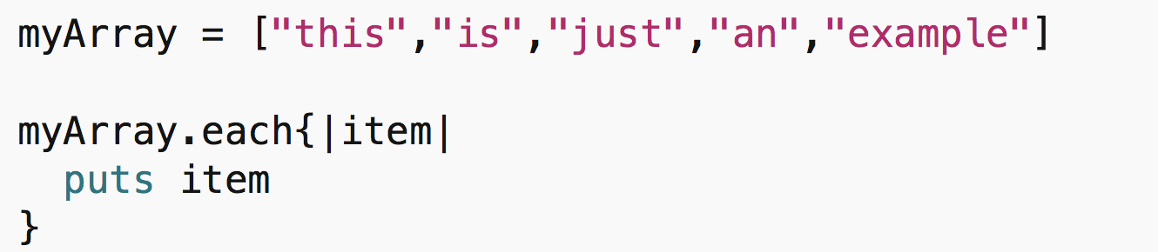
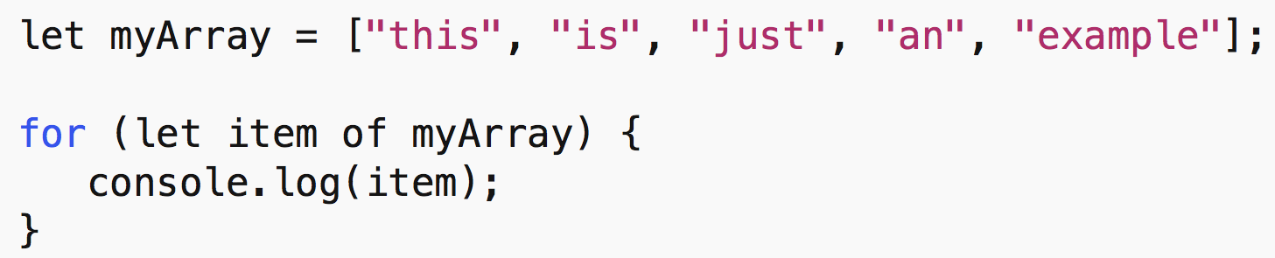
MANY DIFFERENT LANGUAGES
Name some programming languages you know or have heard of.
What’s the difference?
Just syntax!
All programming languages do (basically) the same things
Ruby
JavaScript
Notes:
“Programming languages do pretty much the same thing, they just have slightly different rules of how to communicate those commands”
“Just like how English and Spanish are different languages, but using different words and grammar can communicate roughly the same meanings”

Slide 12
WHAT IS SYNTAX?
What’s syntax?
It’s like grammar in the English language
Rules for understanding
For example…
Notes:
Elicit examples of grammatical rules in English:
Sentences start with capital letter
Sentences end with punctuation mark
Sentences must have a subject and verb, which agree
etc.

Slide 13
WHAT IS SYNTAX?
What’s syntax?
It’s like grammar in the English language
Rules for understanding
For example…
What are some grammatical rules in English?
Notes:
If students are not grasping syntax, it’s OK. Once students see coding in action, they’ll have a strong grasp of the concept.

Slide 14

Notes:
“So, this is us at the top…master programmers”

Slide 15

Notes:
“And here’s our computer”
“We can’t talk directly to our computers, they only understand...”

Slide 16
BINARY
Notes:
“Binary!”

Slide 17

BINARY
Notes:
“We’ll be using Javascript as our interpreter”

Slide 18
BINARY

Slide 19
BINARY
BINARY
Notes:
“Of course, there are other programming languages we could use, like…”

Slide 20

BINARY
BINARY
Notes:
“Ruby, which also serves as an interpreter, does a very similar job.”

Slide 21
BINARY
BINARY
Notes:
“What’s the difference between JS and Ruby, or rather, what’s the difference between one programming language and another?” (elicit - syntax)
Be prepared for students to ask questions about Ruby (or other programming languages) at this point or later on.
Feel free to delve more into why someone might use Ruby (or any other programming language) over JS.
Ruby, in particular, is useful as a backend for web development and is considered significantly easier to learn because it uses “human readable” syntax (it can typically be read literally as it is written).
“Think of JS like a tool in your toolkit: it’s a hammer. You’re building your own house, but all you have is the hammer. How well built will your house be? When you need to screw in the boards, the hammer isn’t the best tool for the job, though you can certainly hammer it in and do an OK-ish job. This is just like JS and other programming languages: each has its own strengths and weaknesses and can serve as the appropriate tool, depending on the job.”
“Also, when you’re applying for a tech job and your employer sees you only know JS, and the person next in line has 10 different programming languages on their resume, who do you think your employer wants to hire?”
“JS is absolutely a strong language to know, and is practically an industry standard, but recognize it will have its limitations and you shouldn’t be married to any one language.”

Slide 22
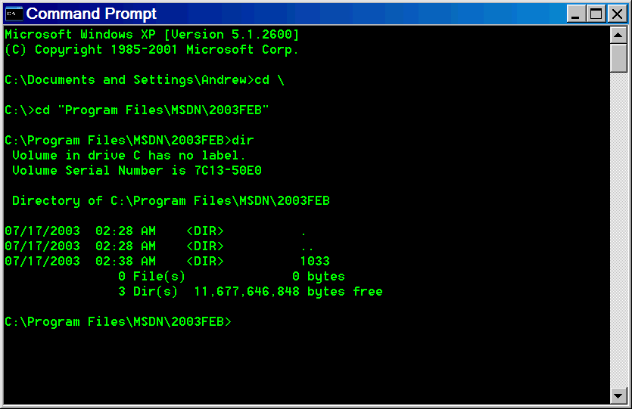
THE COMMAND LINE
Notes:
Explain: With that said, we use something called the “command line” to execute the code we write and to navigate to our files on the computer

Slide 23
THE COMMAND LINE
A command line or command prompt is a “command-line interface” for users to issue commands to their computer.
Example: Using text to move files around from one folder to another, instead of dragging and dropping.
Notes:
Explain: To run JavaScript programs, it is helpful to understand and use the command line. The command line is a tool that you can use to give computers commands. Back in the day, everything was text-based. There were no icons to click on – there wasn’t even a mouse. Today we still use the command line because it runs faster, and we can write code in it!
Ask: The example above is the “move file” command. Can you guess what other kinds of commands might exist?
Answers
Copy a file
Rename a file (actually the same as the move command)
Create a folder / file
Delete a folder / file
Open a folder / file
List the contents of a folder
etc.

Slide 24
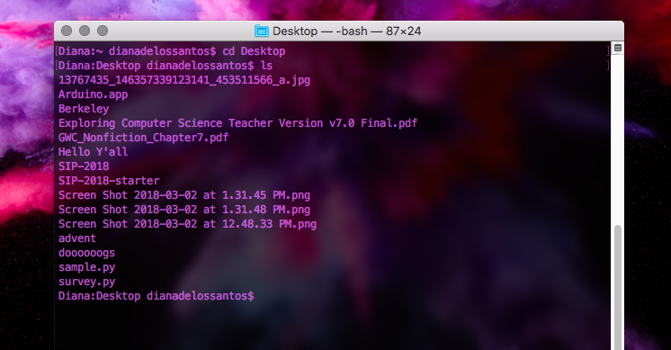
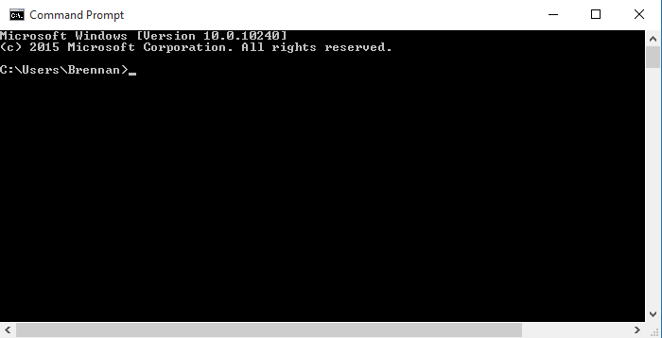
THE COMMAND LINE
MAC OS: TERMINAL
WINDOWS: COMMAND PROMPT
Notes:
Explain: If you are on a Windows computer, this is called the command prompt. On a Mac or linux computer, this is a terminal.

Slide 25
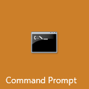
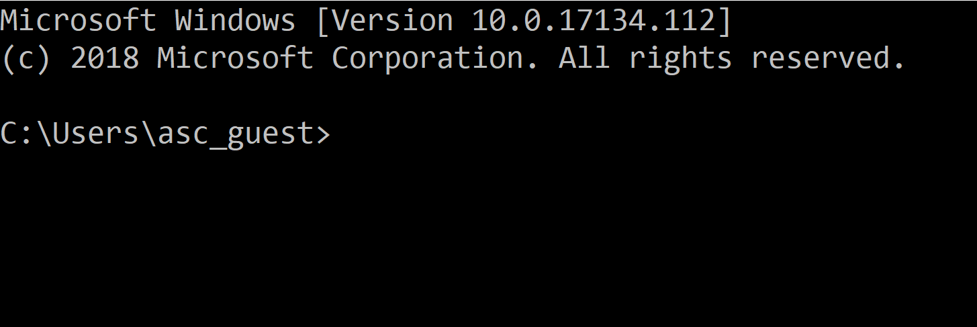
LET’S TALK WITH OUR COMPUTER
Open “Command Prompt” (should be in Start Menu)
Notes:
At this point, begin coding along with students.
If you’re having issues with using Command Prompt, you can always use the console in VisStudioCode as a backup (see here for a modified lecture).
You may want to switch between lecture notes and Command Prompt (alt+TAB).
Feel free to tell your students about this keyboard shortcut and any others you realize you’re using along the way!

Slide 26
NAVIGATION EXERCISE
This is NOT a JavaScript environment
Command line is like a staging area
Developers live in this console (no mouse!)
Swap into JS environment, work, then back to command line
Swap into text editor, work, then back to command line
Notes:
Explain even though the application we opened is called “Command Prompt” it’s a version of a broader term for this kind of console called command line, which is how we’ll refer to it from now on.
Explain to students understanding the fundamentals about how command line works will give them a better understanding of how programming languages (like JS) work.
Ask: Why Developers don’t bother with a mouse?
Answer: Using the command line,
- Gives programmers more control
- Allows programmers to carry out complicated tasks
- Allows the programmer to not be dependent on others in order to do what they want

Slide 27
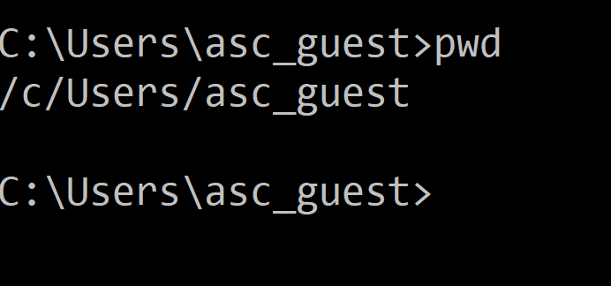
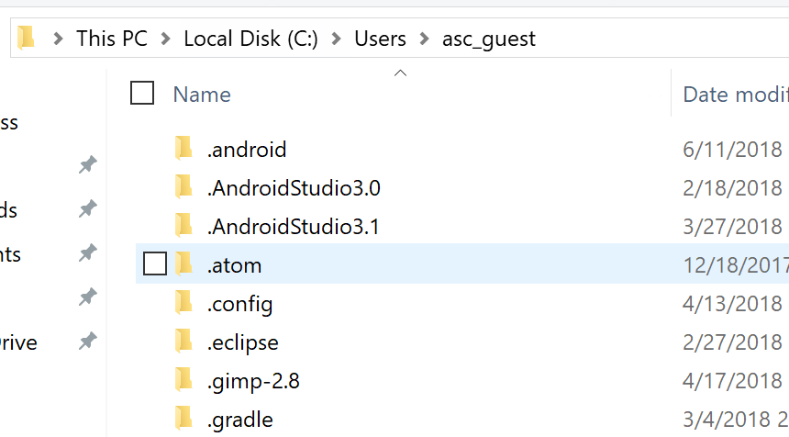
NAVIGATION EXERCISE
First, where are you?
Type pwd in command line
Command Line
File Explorer
Notes:
The first question the computer asks when executing any code is…”where are you?”
The command for asking “where am I right now?” is “pwd” which stands for “Print Working Directory”
Break this down for students. The term “Directory” just means folder. “Working” refers to the folder you’re in right now.
Students are most familiar with the GUI on their computers, so replicate what their current working directory looks like using File Explorer. Setup your screen to show side-by-side what navigating in command line looks like in File Explorer.
Students will have different literal names for their folders, so tell them the words that are printed will be slightly different from yours and the ones on the slides.
Ask students to explain what the C:// stands for - elicit: “Hard Drive ‘C’”
And the rest - elicit: “On the slide, we’re in the ‘Jordan Brodie’ folder, which is in the ‘Users’ folder, which is on the ‘C’ drive”

Slide 28
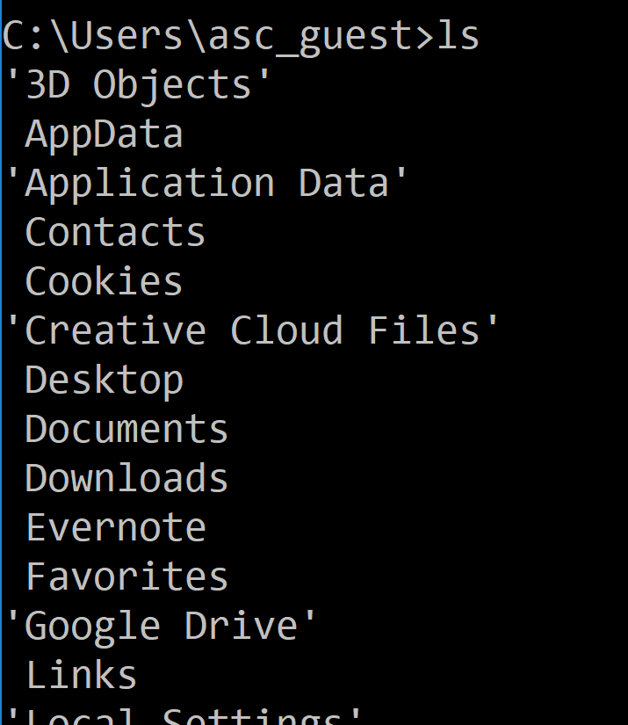
NAVIGATION EXERCISE
What’s around?
Type ls in command line
Command Line
File Explorer
Notes:
“Let’s see what’s in our working directory with ‘ls’”
‘ls’ lists all files and directories
It may not appear in the same order as seen w/File Explorer

Slide 29
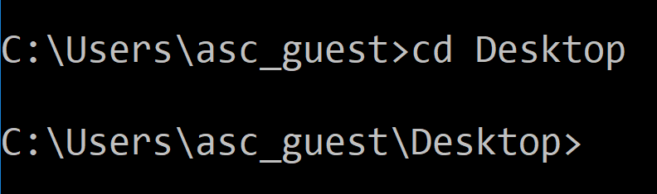
NAVIGATION EXERCISE
Move into a Directory
cd Desktop
Command Line
Notes:
“We’re going to make your own personal Directory where you’ll store all of your files from now on, but let’s put it on your Desktop, so it’s easy to find”
“First, let’s navigate into the Desktop folder”
‘cd’ stands for Change Directory
“I’ll type in ‘cd des’ and them, because I’m a lazy programmer, I’ll just hit ‘Tab’ and the computer will auto-complete for me”
(SIDE NOTE: always be mindful of what you’re pressing on the keyboard as an instructor. These small tips and tricks are exactly what students want to know about, so tell them explicitly what you’re pressing and why. The UP-ARROW to cycle through your history is another great tip).
“Notice our location changed! How can I check to see what’s in my Desktop Directory?” elicit- ‘ls’ command
Note: if a student get’s lost at this point, help them navigate using “ls” and “cd” with them inputting the commands (do NOT touch a student’s keyboard).

Slide 30
NAVIGATION EXERCISE
Move back out of a Directory
cd ..
Command Line
Notes:
“We can jump back to the parent folder by typing ‘cd’ space and two periods”
“Go back into the Desktop folder”
Feel free to explain a single period represents the current folder - cd . doesn’t change anything, but we’ll see later why this self reference is important!
Ensure all students to get to this point before moving on

Slide 31
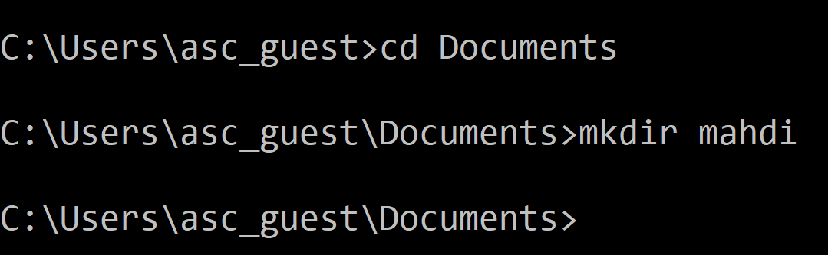
NAVIGATION EXERCISE
Move into the “Documents” folder
Make a folder with your name
mkdir {your name}
Command Line
Notes:
“Now that we’re all in the Desktop, let’s make a Directory using our own names”
“Type in ‘mkdir’, which stands for Make Directory, followed by a space and the name we want”
“We can check if it’s there with ‘ls’”

Slide 32
NAVIGATION EXERCISE
Make a file “bob.js”
touch bob.js
Command Line
Notes:
Creating a file is a little different
While still in the Desktop, type “touch”, space, and ‘bob’ followed by ‘.js’ (no space around the period)”
NOTE: we are purposefully naming it bob.js as a practice for them to rename the file later.
“You’ll be using this file as your own JavaScript Library later on”
“Unfortunately, we forgot to put bob.js in our named Directory!...(not really...)”

Slide 33
NAVIGATION EXERCISE
Oops! We made the file outside of your directory...move your file into your directory
mv bob.js {your Directory name}
Command Line
Notes:
“Let’s move our folder with the ‘mv’ command”
‘mv’ stands for move and it takes a file and puts it into a Directory, both of which we need to specify
“Type ‘mv’ space ‘bob.js’ space and then the name of your directory”
Some students might have spelled some words with a capital letter and are running into issues
Stress the importance that each letter and space matters, and that upper and lower casing also matters.

Slide 34
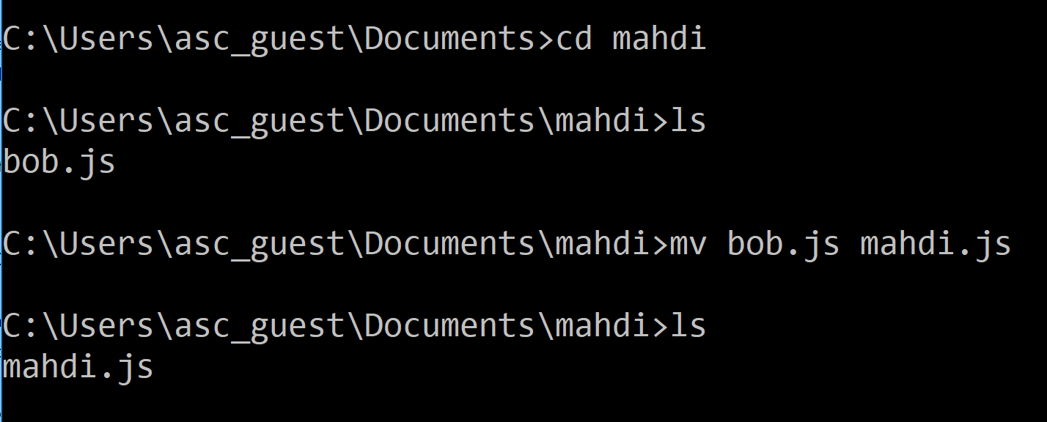
NAVIGATION EXERCISE
Navigate into your directory
cd {your Directory name}
Rename the file
mv bob.js {your name}.js
Command Line

Slide 35
NAVIGATION EXERCISE
Navigate out of your directory
cd ..
What else is in the “Documents” directory?

Slide 36
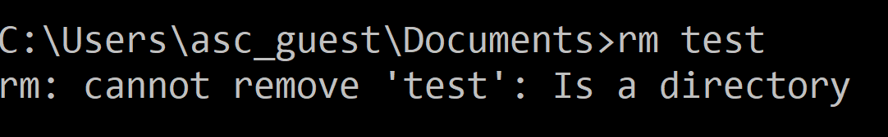
NAVIGATION EXERCISE
Oh no! Mahdi left the “test” folder on your computer - let’s delete it!
rm test
Command Line

Slide 37
NAVIGATION EXERCISE
Oops. “rm” is meant for files, not folders.
Modify our command...
rm -rf test
Command Line
Notes:
Mentions that this not only deletes the folder, but all of the content inside of it, too!

Slide 38
LIST OF BASIC COMMANDS
pwd : print working directory
ls : lists the files in the working directory
cd {path} : changes the directory to the path
mkdir {name} : creates a directory
touch {file} : makes a file in the working directory
mv {file} {path or newfile} : moves or renames a file
rm {file} : removes a file
rm -rf {directory} : removes a directory (including files in it)
Notes:
Show students the list of commands they’ve just learned.
The last two we didn’t go over, but they’re worth knowing
They will delete permanently!
“Removing a file or directory in command line is NOT like putting it in the “Trashcan” where you can undo the deletion.”
“These are permanent, so use with caution!”
Many more commands
“What questions do you have for me?”
We’ll be moving onto JavaScript after this.

